Slide 1


CityWatch
A Comprehensive Surveillance and Analysis Platform for Smart Cities

Slide 2
Team
Shruti Sharma | 20BCS3639
Vinit Kundu | 20BCS3636
Aayush Somankar 20BCS3641
Anurag Rawat 20BCS3648
Akshay Kumar 20BCS3624

Slide 3
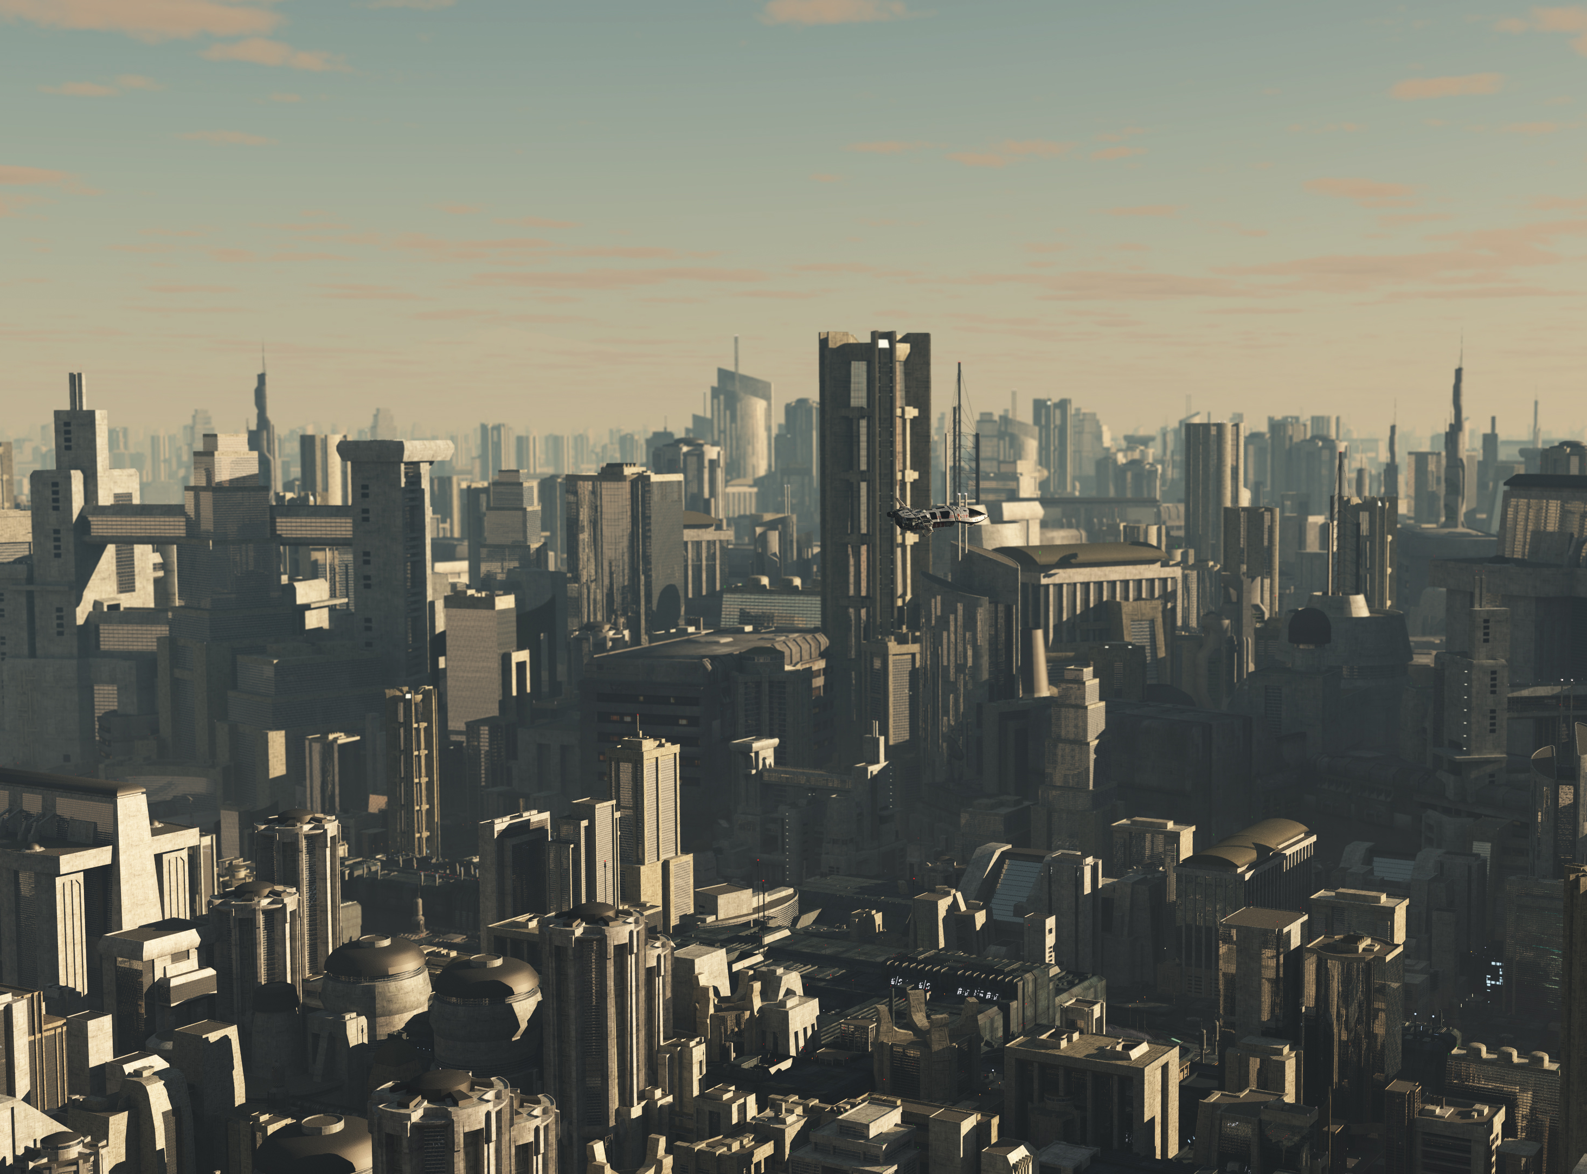

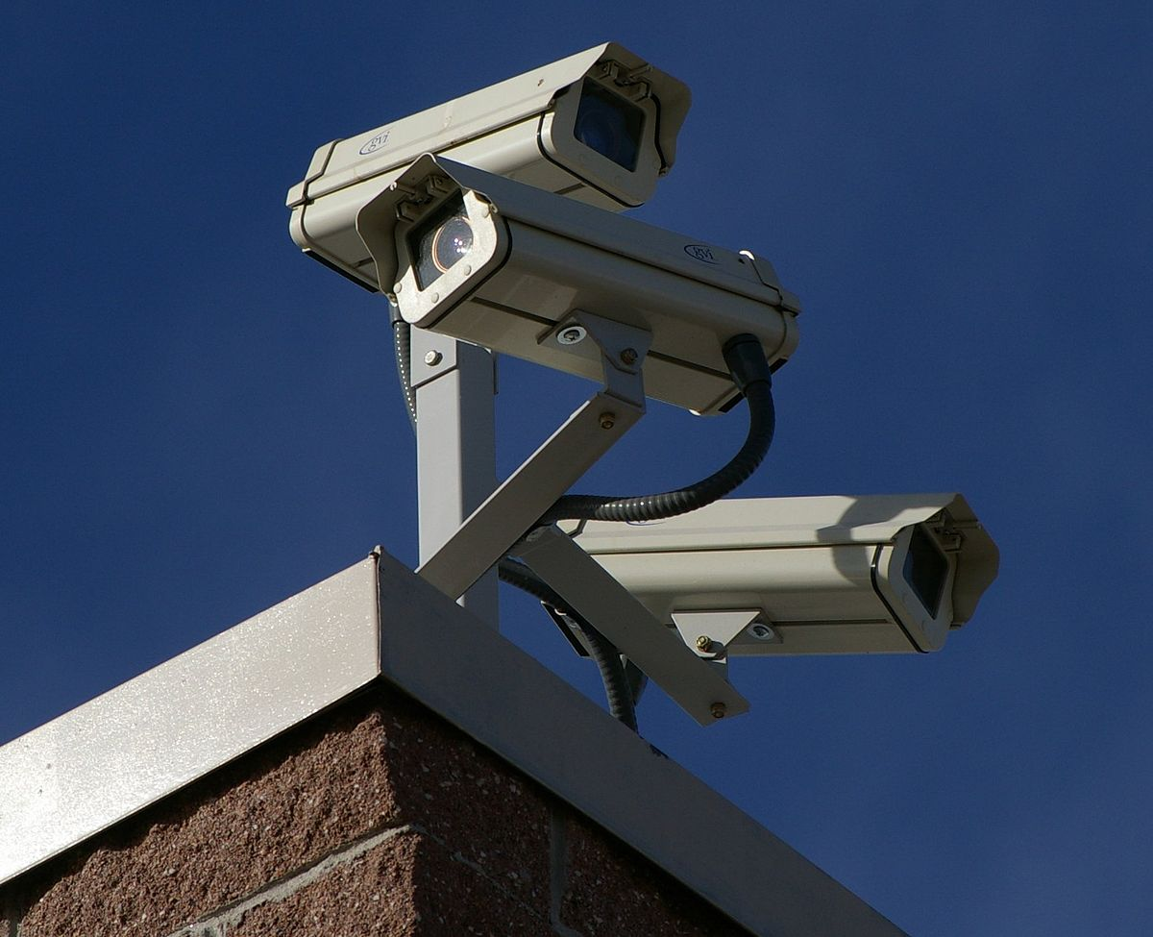
Problem Statement:
Cities today face a growing number of security challenges and risks, including crime, terrorism, and natural disasters. Traditional surveillance systems, such as CCTV cameras, are often limited in their ability to provide comprehensive surveillance coverage and real-time analysis of data. This can make it difficult for city officials and first responders to quickly identify and respond to potential security threats.

Slide 4
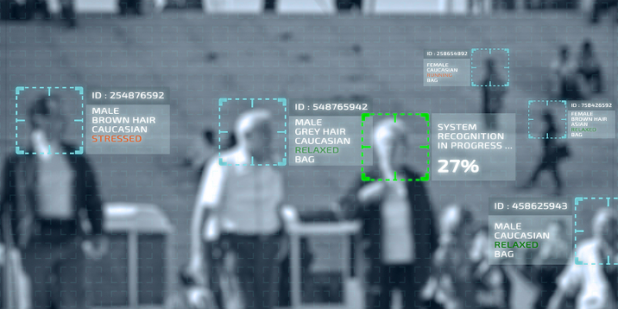
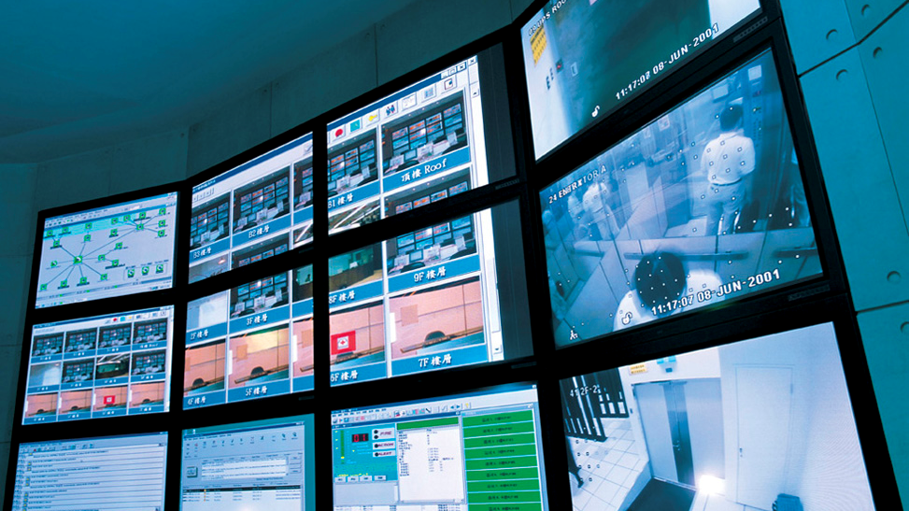
Solution
The goal of this project is to develop a software-based solution that integrates multiple data sources, such as CCTV cameras, social media, and weather sensors, to provide a real-time view of the city's surveillance status. The solution will use machine learning algorithms and computer vision techniques to analyze the data and detect patterns and anomalies that could indicate a security threat. The solution will also include a user-friendly interface that allows city officials and first responders to monitor and control the surveillance system in real-time, as well as replay and analyze footage from past events. The solution should also have the ability to generate real-time alerts and recommendations for city officials and first responders in case of emergency

Slide 5
Technology Used
Computer Vision
Machine Learning
React
Next.js
Python

Slide 6
Use Cases/Applicability
Disaster response coordination.
Surveillance all over city i.e. Road Traffic as well as Markets.
Can be used by Police to efficiently caught a suspect. (Person or Vehicle).
This project can be applied on all over the road and markets.
This can also be applied for indoor surveillance like malls or Campus, Buildings.
Proposed project can keep log of all face data in that area.

Slide 7
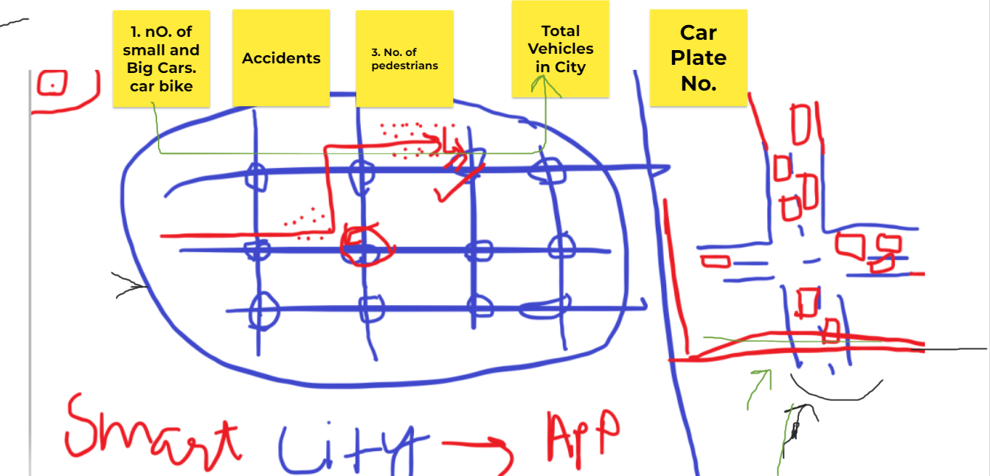
Road Traffic Scenario

Slide 8
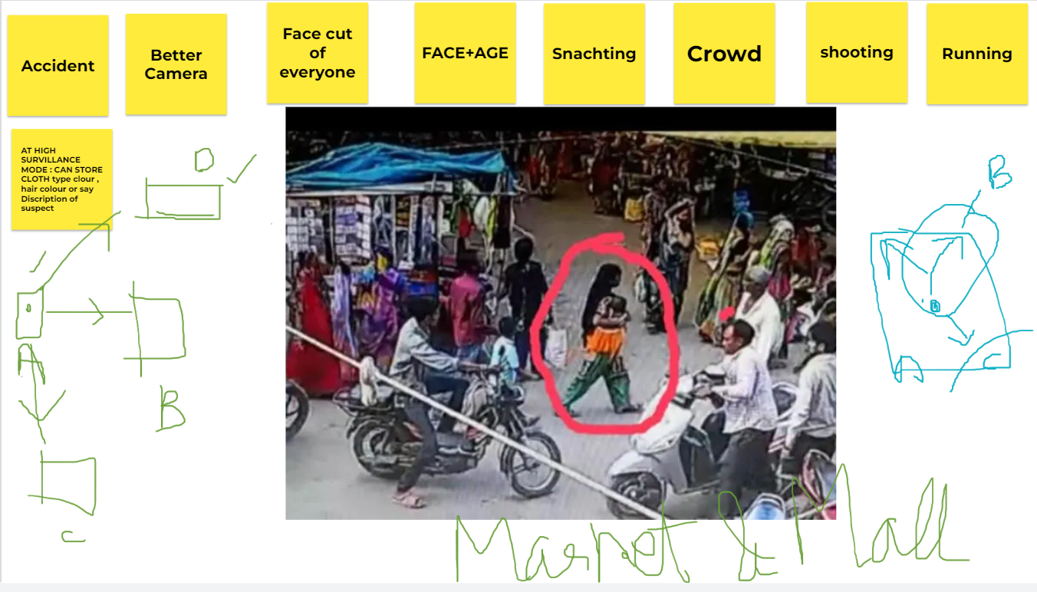
Market Scenario

Slide 9
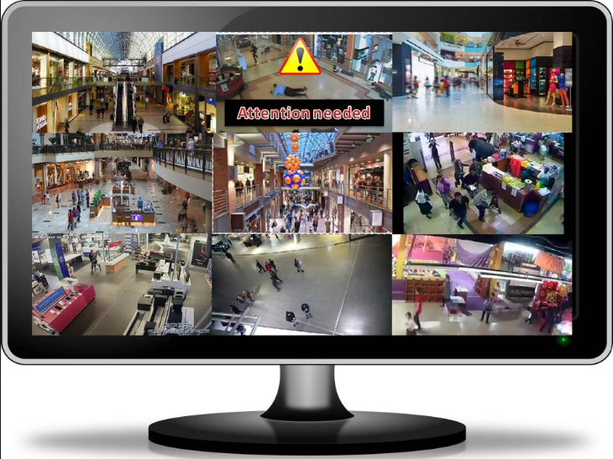
Scale of Impact
Town.
Big Cities.
Metro Stations.
Reduced loss of life and property: Early warning and rapid response can help minimize the loss of life and property.
Increased disaster resilience: Monitoring and analyzing trends and patterns can help cities better understand and prepare for natural disasters, increasing their overall resilience.
Better data collection and analysis: The collection and analysis of real-time data from smart city surveillance systems can provide valuable insights into the causes and impacts of natural disasters, enabling cities to make more informed decisions about disaster response and preparedness.
Increased public safety: Smart city surveillance systems can help to increase public safety by providing real-time information about the location and severity of natural disasters, allowing residents to take appropriate actions to protect themselves and their property.

Slide 10
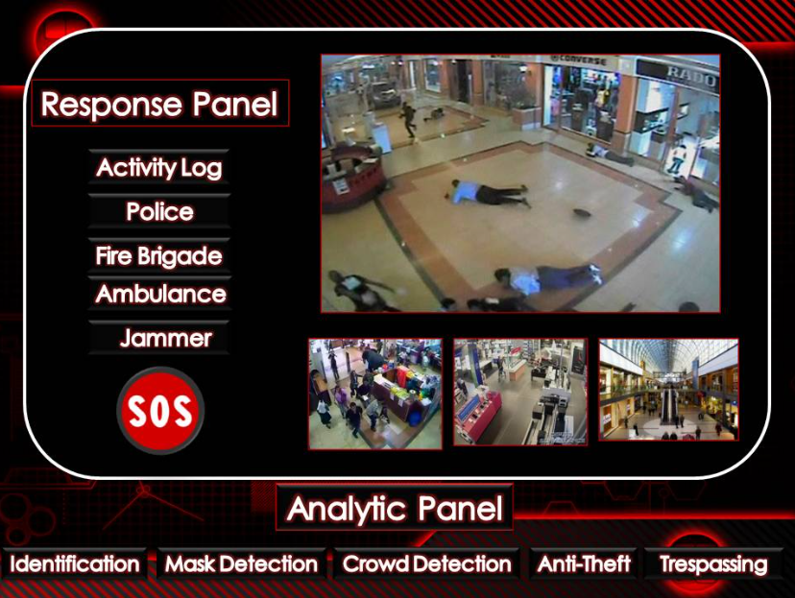
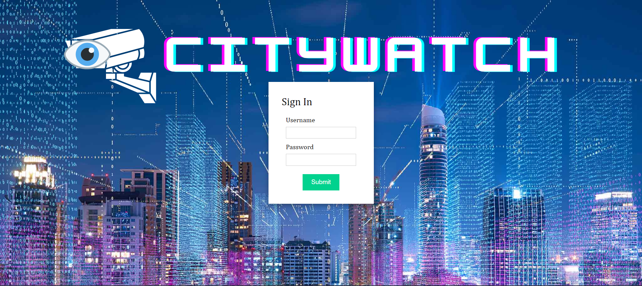
UI CONCEPT

Slide 11
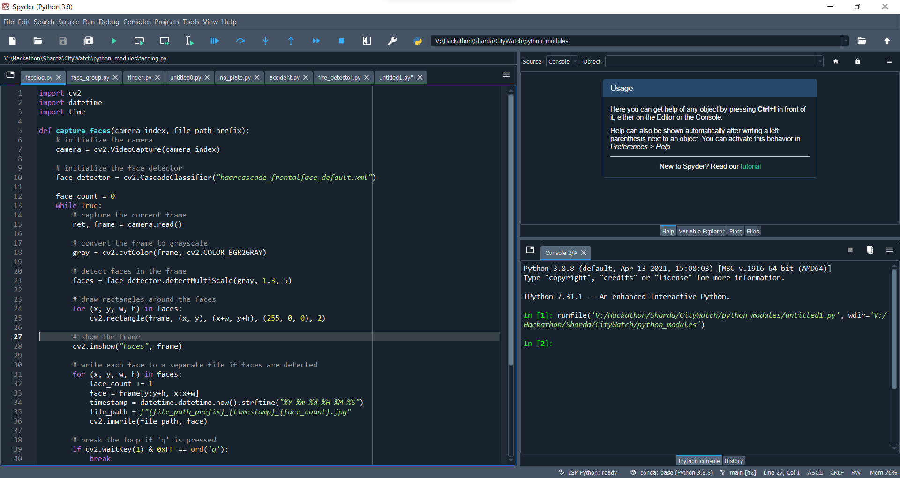

Slide 12
References
https://en.wikipedia.org/wiki/Surveillance_issues_in_smart_cities.
https://www.ibm.com/in-en/topics/computer-vision#:~:text=Resources-,What%20is%20computer%20vision%3F,recommendations%20based%20on%20that%20information.
https://nextjs.org/docs
https://towardsdatascience.com/vehicle-detection-and-tracking-44b851d70508
https://www.sciencedirect.com/science/article/pii/S095741742100823X

